Slide 1
VOLUNTEERING REFLECTIONS

Slide 2
How your volunteering has impacted you
Volunteering has made me a better person in whole, its helped with my patience, I now know to take a breath and just deal with what the situation is. Its also sparked a passion and willingness to help others, ever since I was little I liked the feeling of helping people and when I realised I could do that through volunteering, I never looked back. Its made me more confident in not only myself but my decision making and putting trust into what I do but it has also booked my confidence in speaking to a large group of people and being sociable as that has always been an issue due to anxiety.
Notes:
Volunteering has made me a better person in whole, its helped with my patience, I now know to take a breath and just deal with what the situation is. Its also sparked a passion and willingness to help others, ever since I was little I liked the feeling of helping people and when I realised I could do that through volunteering, I never looked back. Its made me more confident in not only myself but my decision making and putting trust into what I do but it has also booked my confidence in speaking to a large group of people and being sociable as that has always been an issue due to anxiety.

Slide 3
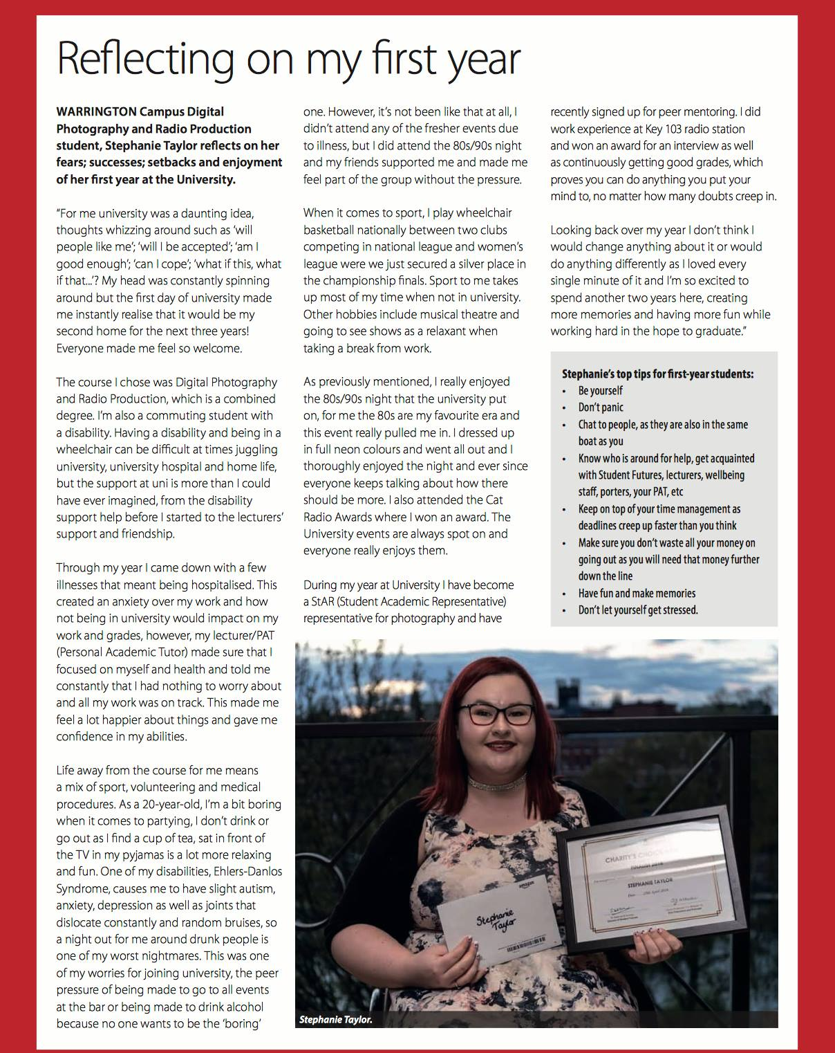
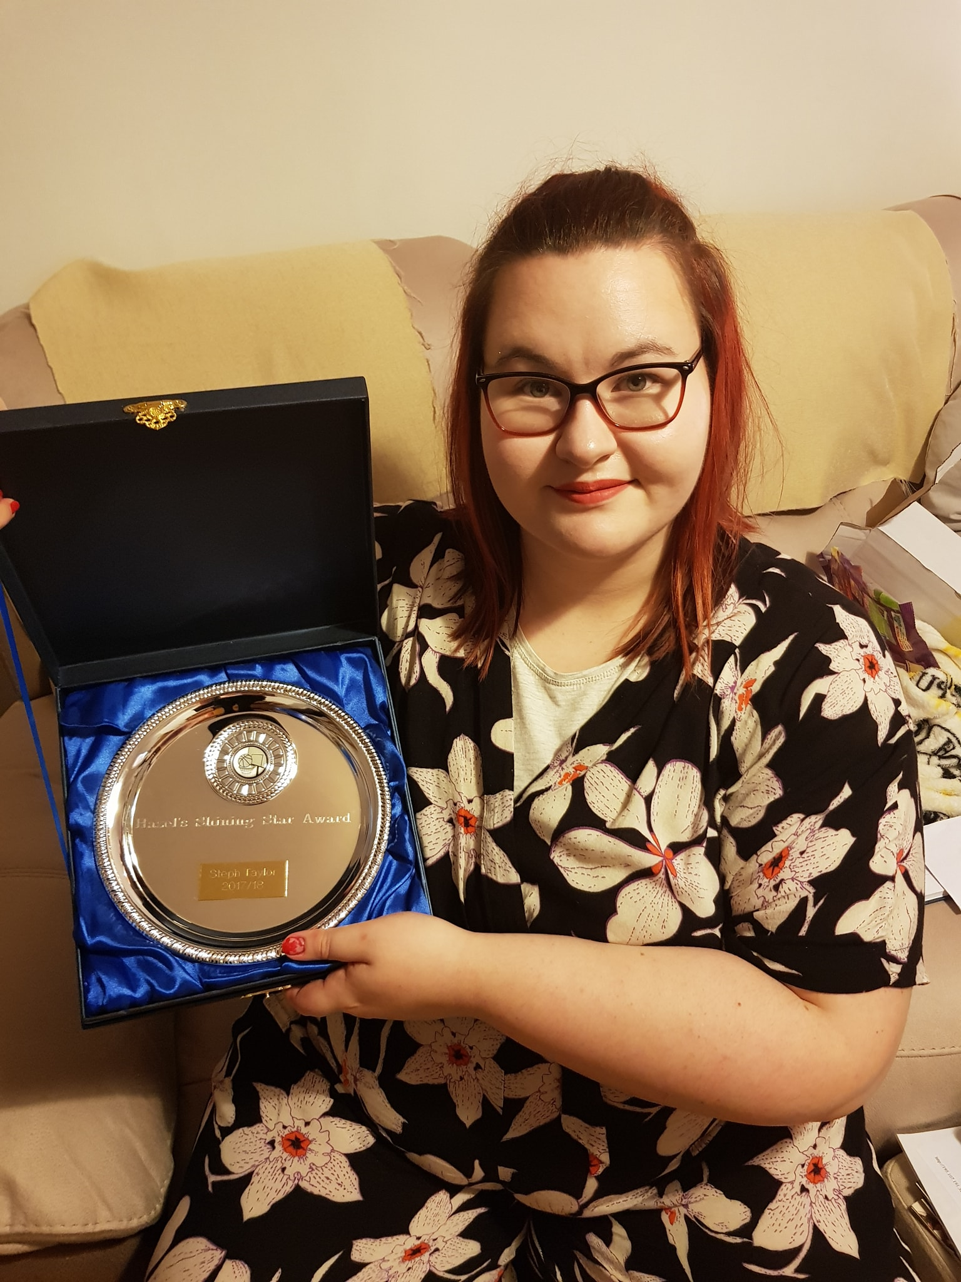

Slide 4
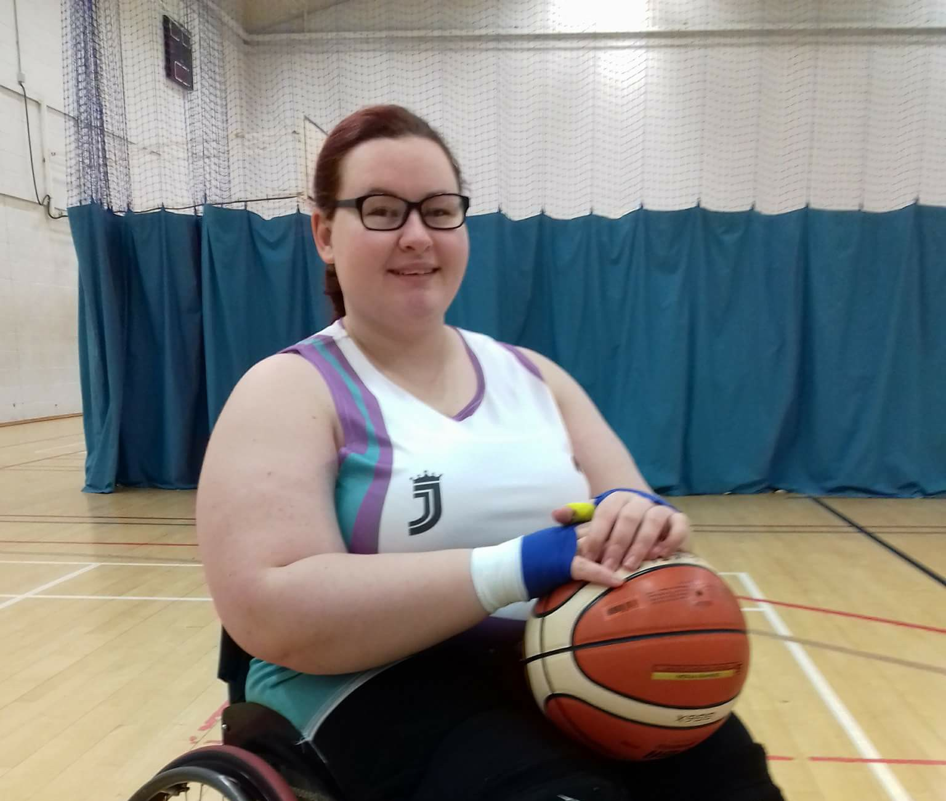
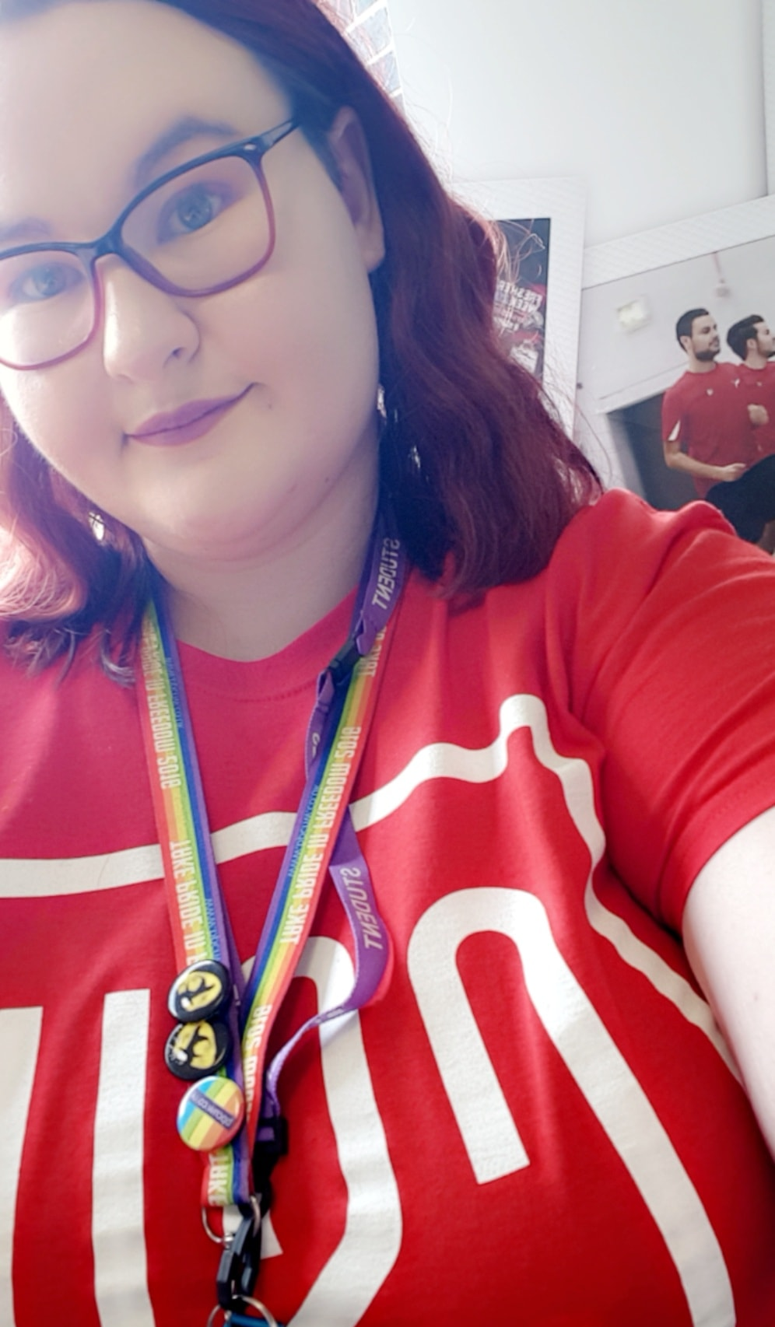
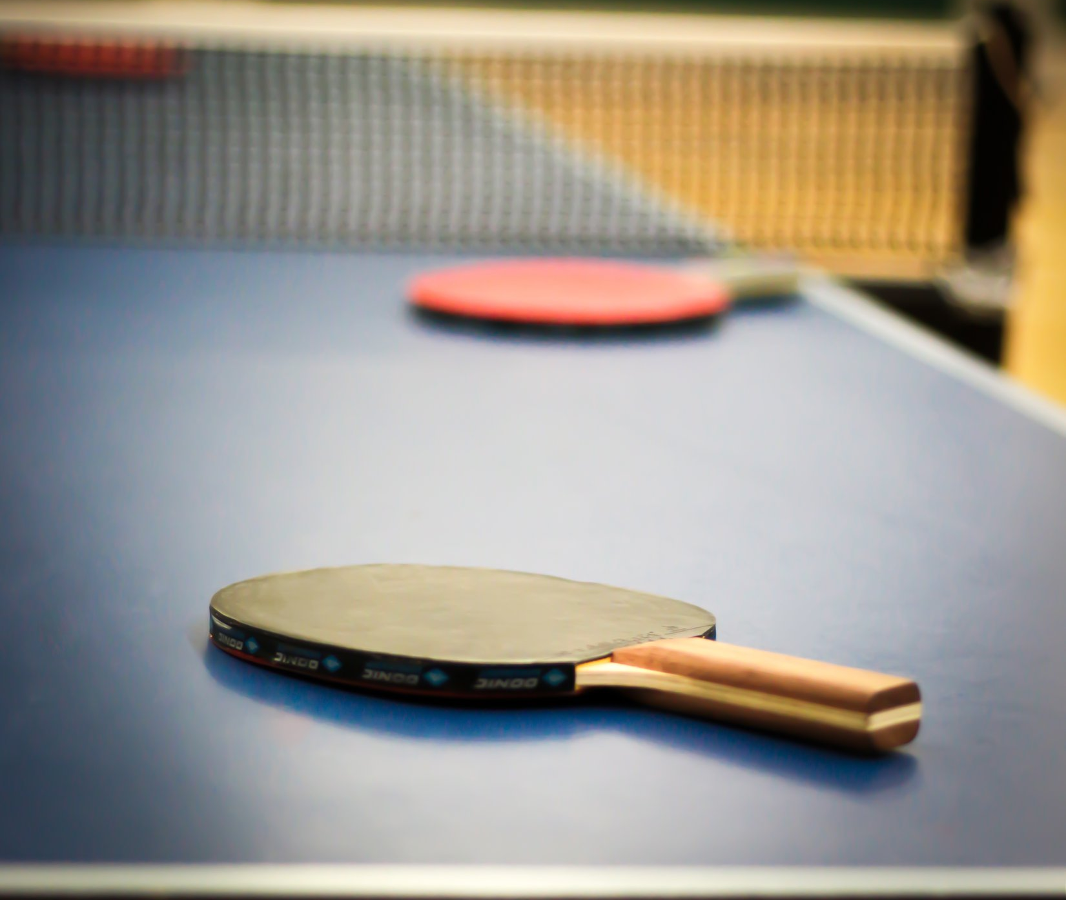
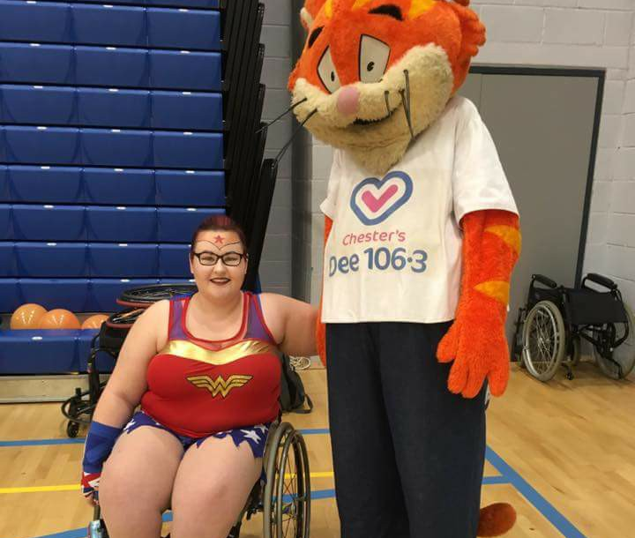
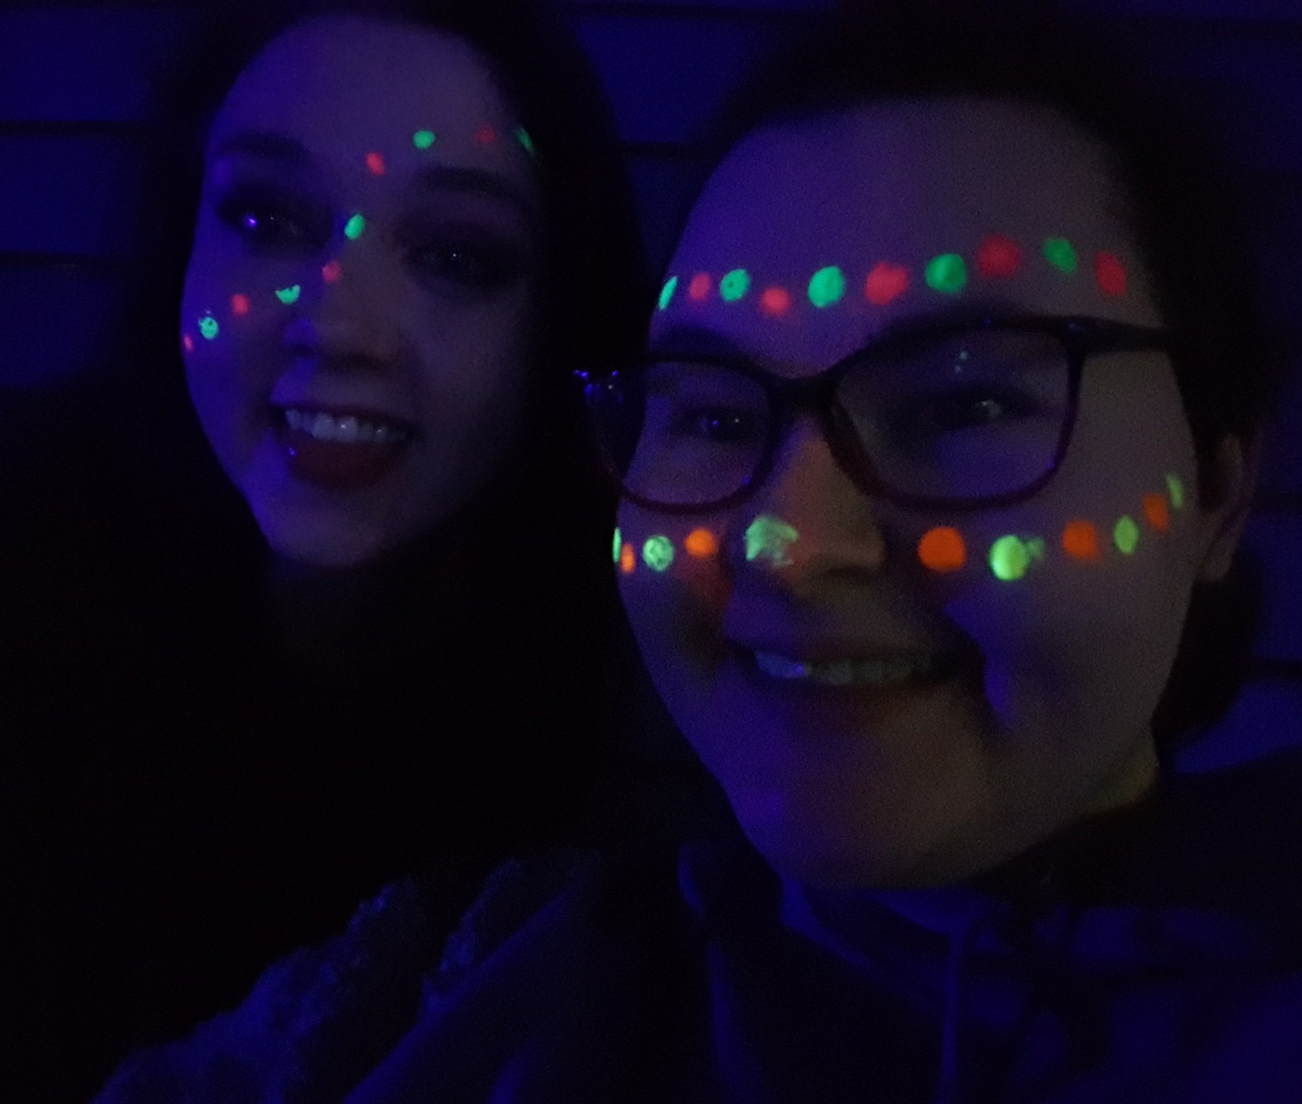

Slide 5
How your volunteering has impacted the community and others
Feedback given from people who I help has been that I'm always there, they can rely on me because I get things done, I always say yes to everything and I always go the extra mile to help, they also say that I make them smile and they are always happy to see me. Quite a few times I've jumped in and helped when others couldn't and that sometimes has really saved them because I could of just said no but by saying yes and getting stuck in I've gotten them out of sticky situations and been there for them. Ive created a happy place no matter where I am, I make sure I bring smiles, laughter and some sense of humour and spread that around everyone so when others may be having a bad day I've made sure to lighten the mood and get everyone in a positive spirit which can really have an impact on an atmosphere. I also help people feel like they have achieved something massive so at basketball I take time to sit with individuals who need help either practising how to bounce a ball or shoot in a small hoop and by being able to share my own knowledge and experience and pass it on to them, its a big thing to witness and then when they achieve their goal and I see them with a beaming smile and laughing with joy, thats all worth while, that is the thing that keeps me motivated because I know I have impacted their life some how and helped them. I also do a lot of media work and help promote events and just the club in general which means other people get to see it and they then come along and because they come along they then find something they absolutely love and just by creating that poster and getting it out there its meant someone has seen it and suddenly found a sport they love and adore.

Slide 6
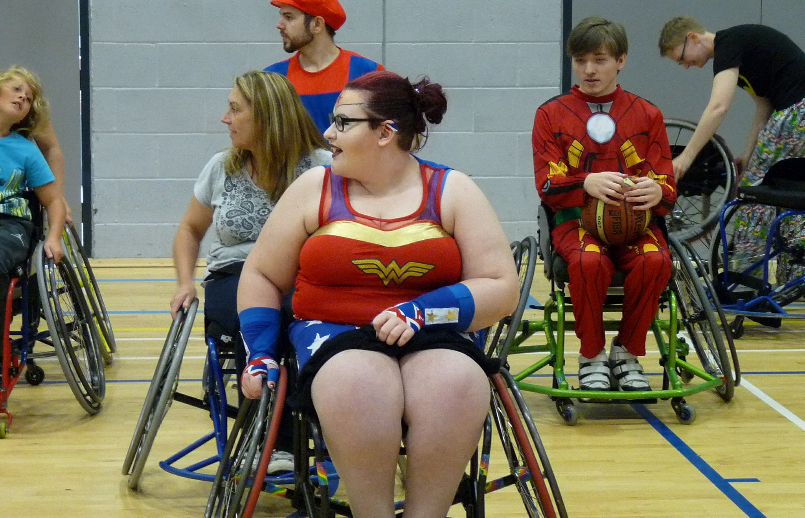
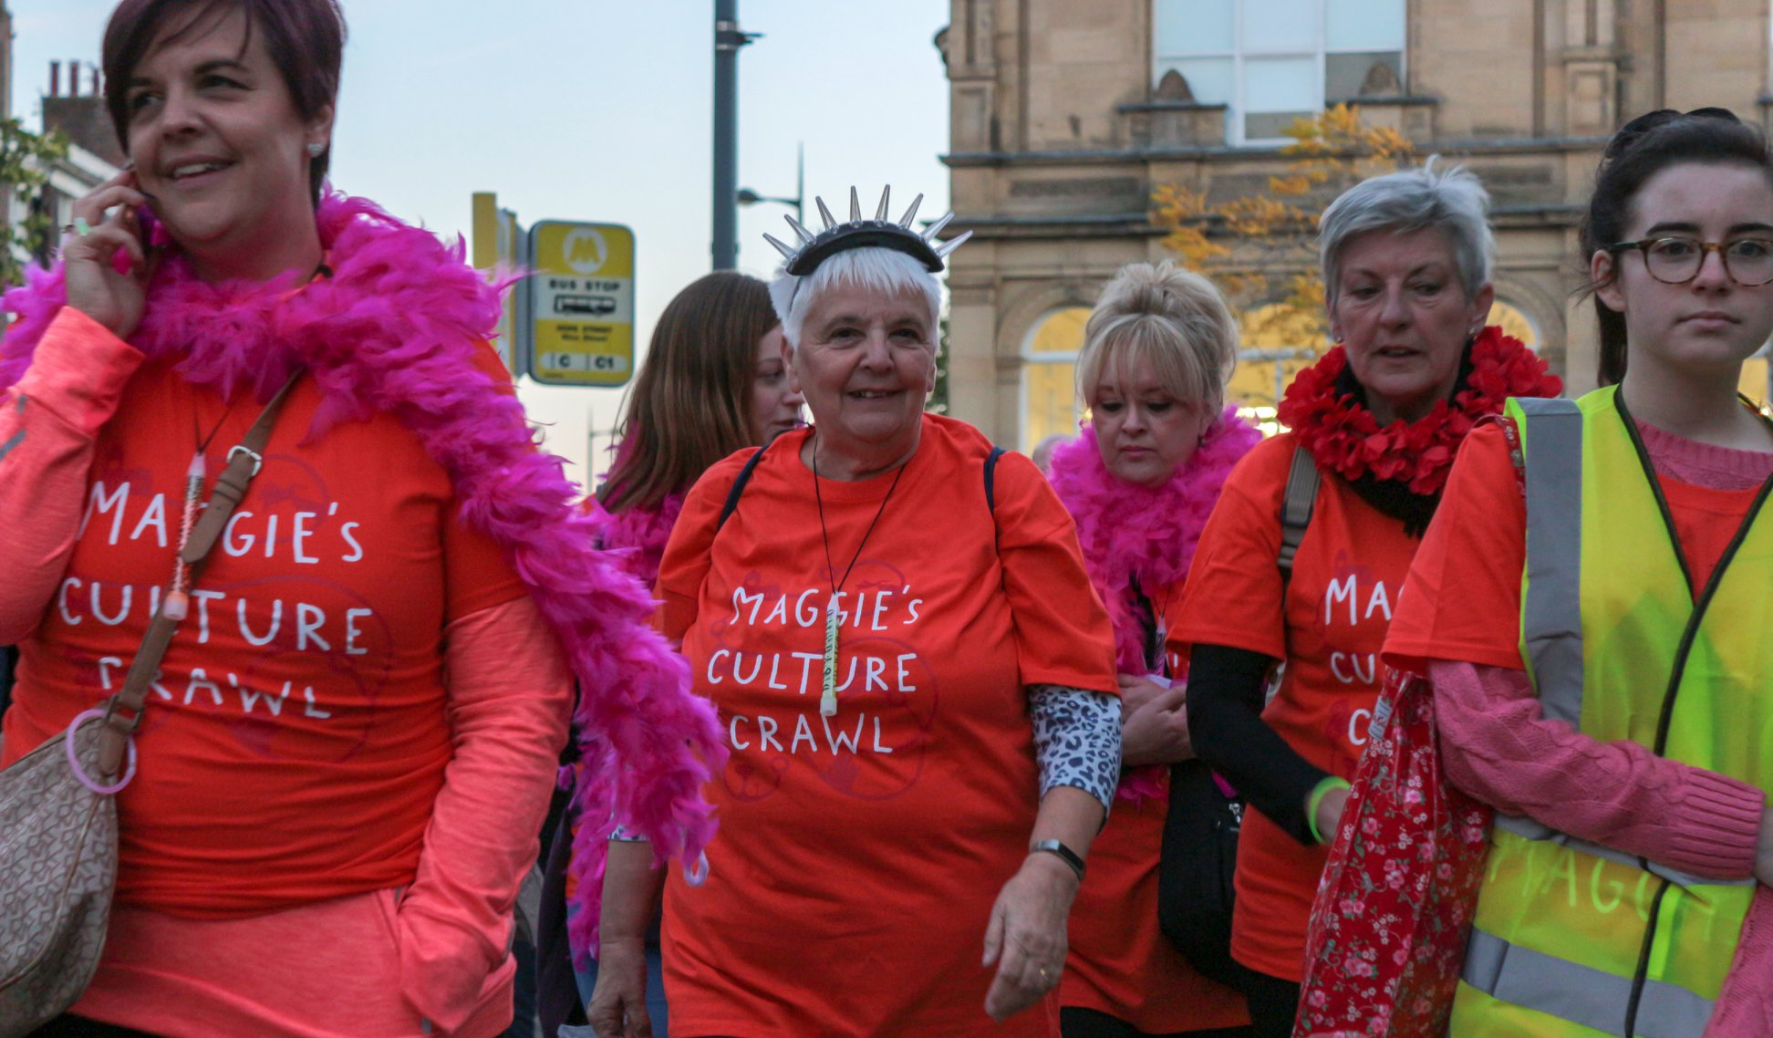
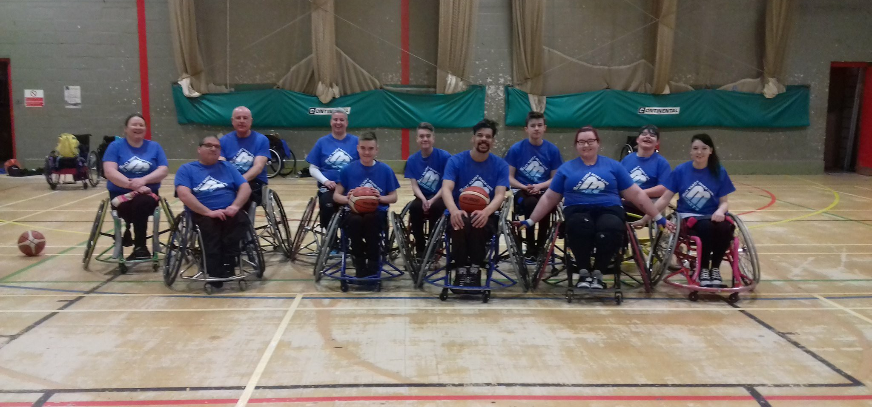
Notes:
Feedback given from people who I help has been that I'm always there, they can rely on me because I get things done, I always say yes to everything and I always go the extra mile to help, they also say that I make them smile and they are always happy to see me. Quite a few times I've jumped in and helped when others couldn't and that sometimes has really saved them because I could of just said no but by saying yes and getting stuck in I've gotten them out of sticky situations and been there for them. Ive created a happy place no matter where I am, I make sure I bring smiles, laughter and some sense of humour and spread that around everyone so when others may be having a bad day I've made sure to lighten the mood and get everyone in a positive spirit which can really have an impact on an atmosphere. I also help people feel like they have achieved something massive so at basketball I take time to sit with individuals who need help either practising how to bounce a ball or shoot in a small hoop and by being able to share my own knowledge and experience and pass it on to them, its a big thing to witness and then when they achieve their goal and I see them with a beaming smile and laughing with joy, thats all worth while, that is the thing that keeps me motivated because I know I have impacted their life some how and helped them. I also do a lot of media work and help promote events and just the club in general which means other people get to see it and they then come along and because they come along they then find something they absolutely love and just by creating that poster and getting it out there its meant someone has seen it and suddenly found a sport they love and adore.

Slide 7
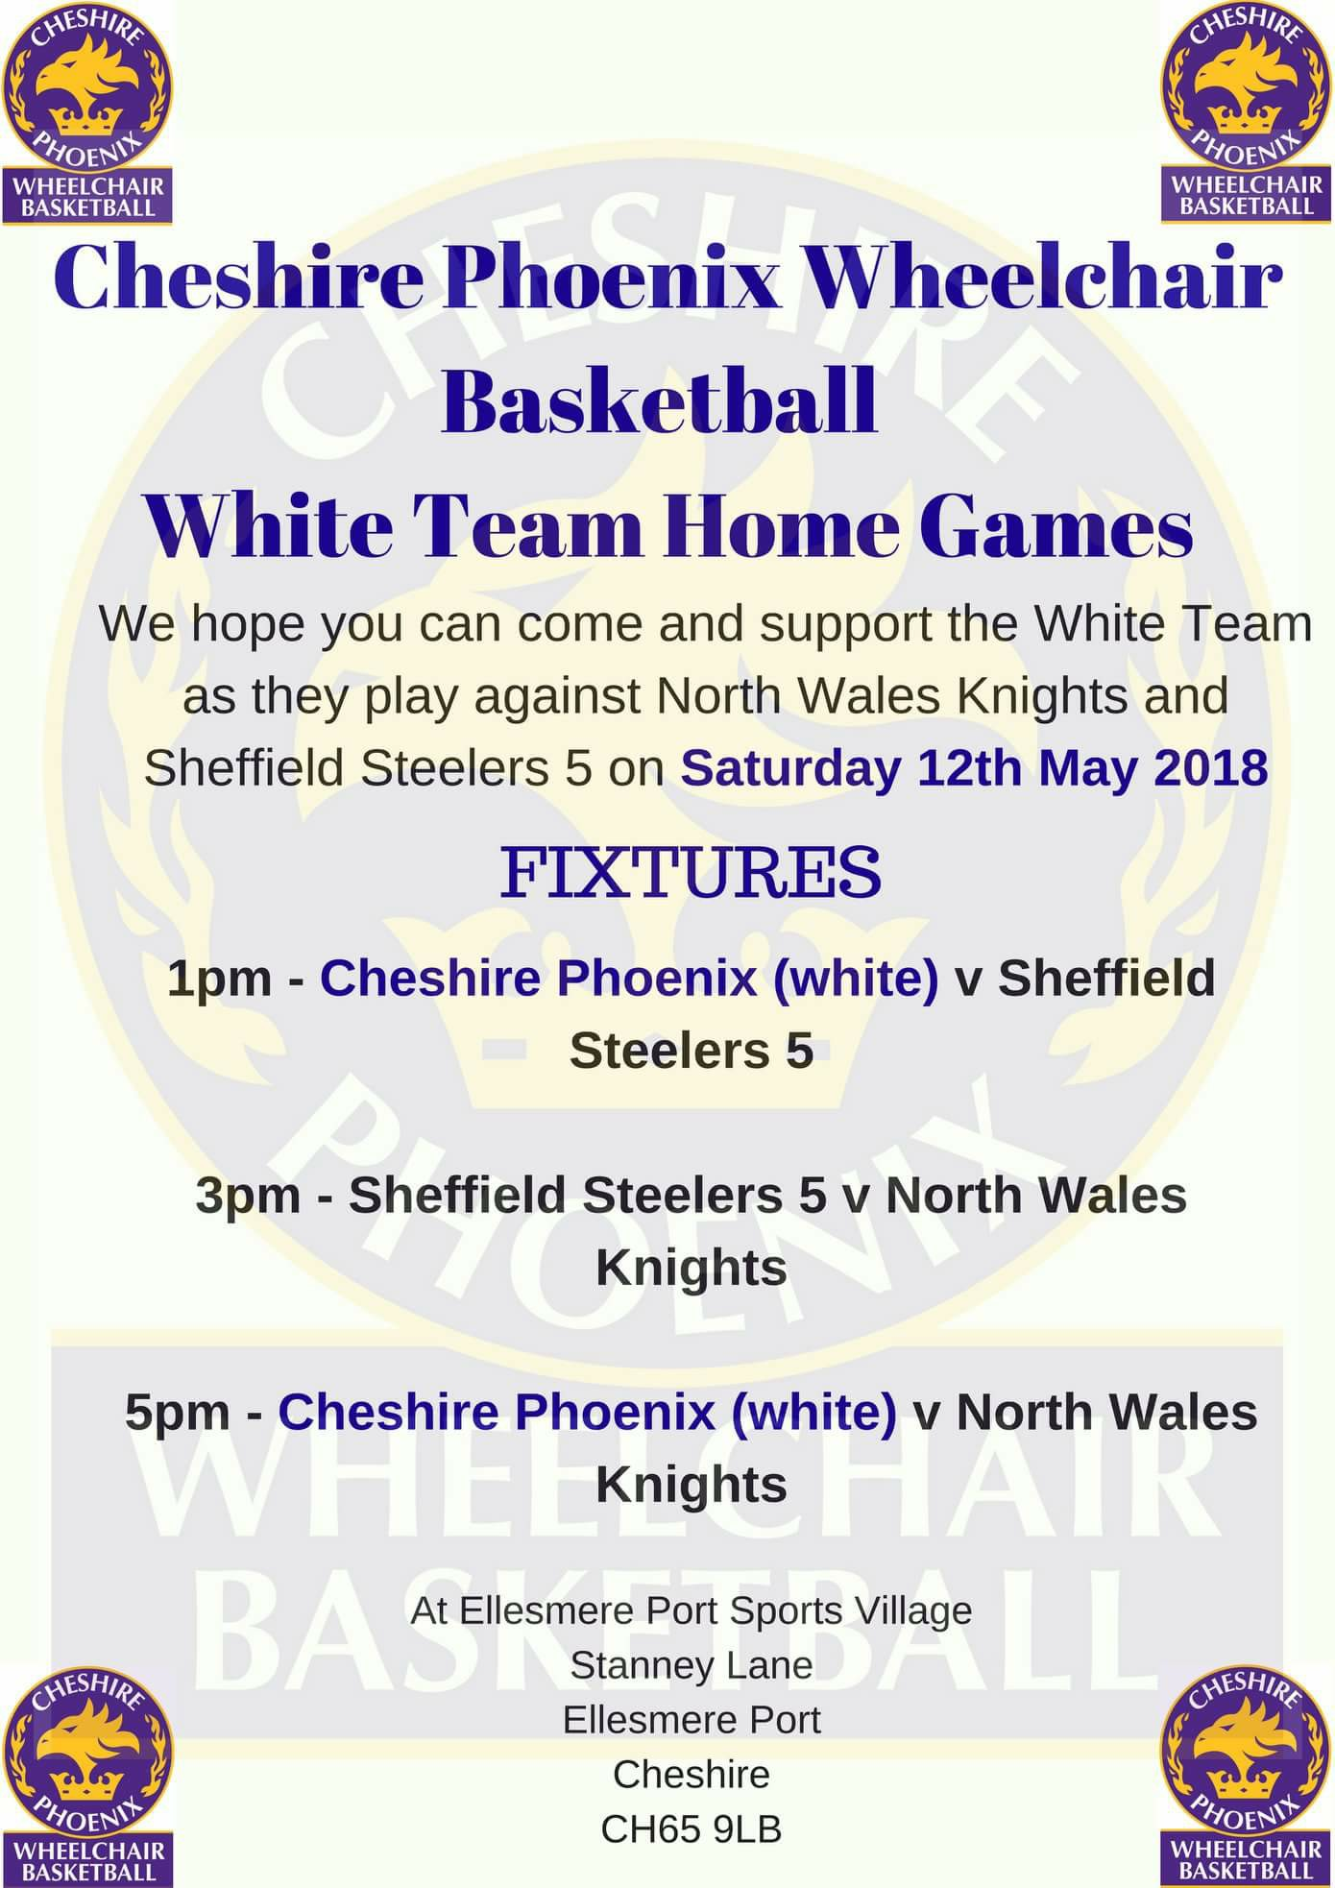
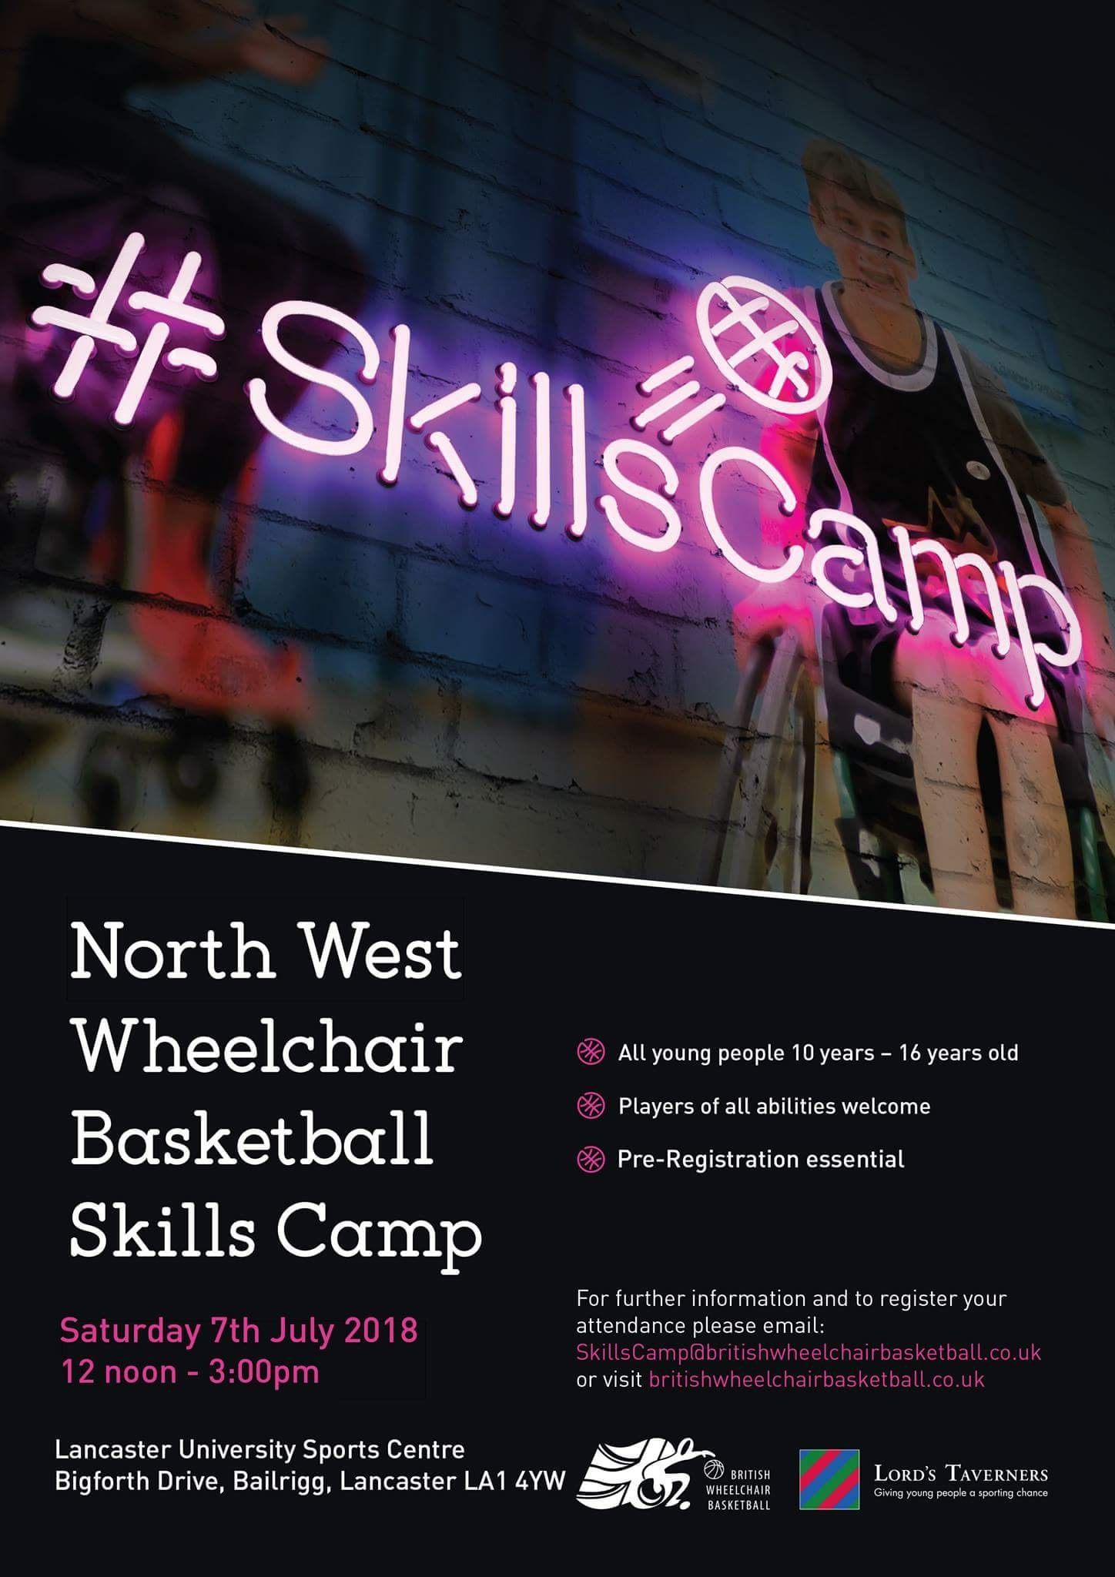
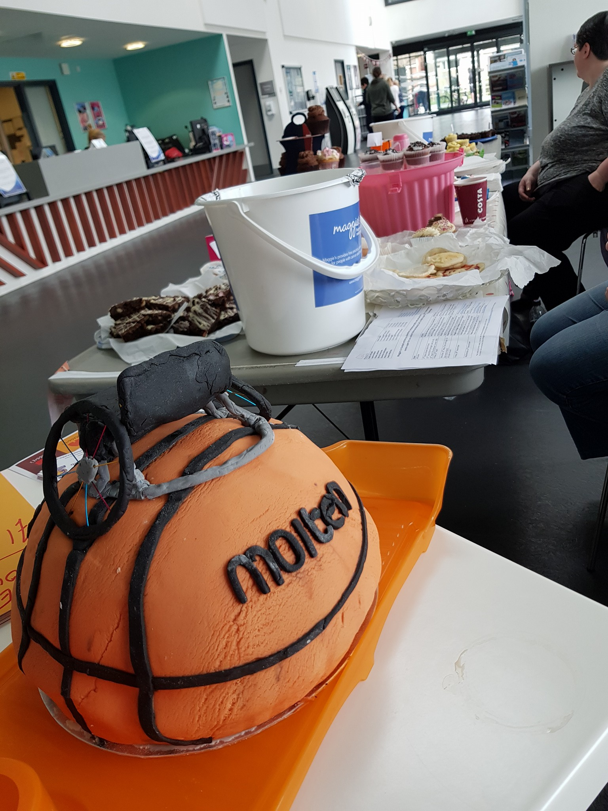

Slide 8
Your volunteering and it's impact on your future career
The volunteering that I've done over the years has definitely not only built me up to a point where I can go into work and be ok but also opened up many doors for me that I would never of come across if I hadn't of volunteered, its also shown my skills and helped me add new things onto my CV which makes me more employable. Its meant that employers will look at my CV and see the vast range of places I volunteer but also all the skills and achievements listed which if they ask about I can really go into depth about. It has taught me valuable life skills to and helped me with my own independence. Many times I have been thrown into the deep end but that’s something I now love doing because I know that I can make any situation work and it always ends with a good result. I will always keep volunteering even if I am in work because its part of me and my passions in life and even when working it is important to keep adding to that list of new skills and knowledge.
Notes:
The volunteering that I've done over the years has definitely not only built me up to a point where I can go into work and be ok but also opened up many doors for me that I would never of come across if I hadn't of volunteered, its also shown my skills and helped me add new things onto my CV which makes me more employable. Its meant that employers will look at my CV and see the vast range of places I volunteer but also all the skills and achievements listed which if they ask about I can really go into depth about. It has taught me valuable life skills to and helped me with my own independence. Many times I have been thrown into the deep end but that’s something I now love doing because I know that I can make any situation work and it always ends with a good result. I will always keep volunteering even if I am in work because its part of me and my passions in life and even when working it is important to keep adding to that list of new skills and knowledge.

Slide 9
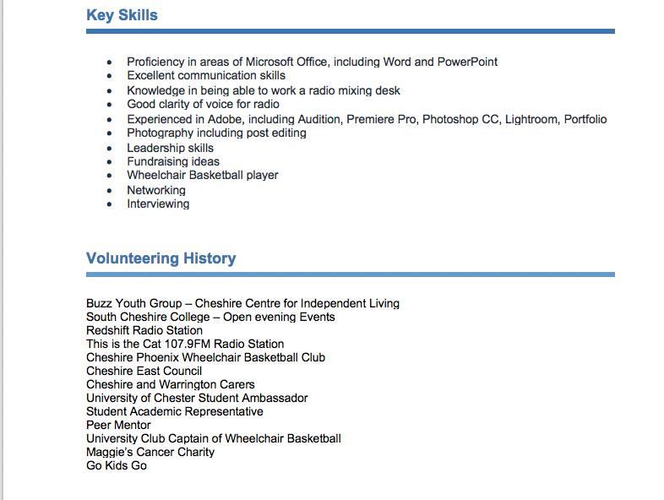
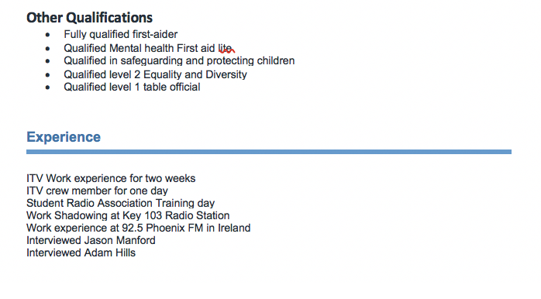

Slide 10
“A world of volunteers is a world that moves forward” - Steph

